Slide 1
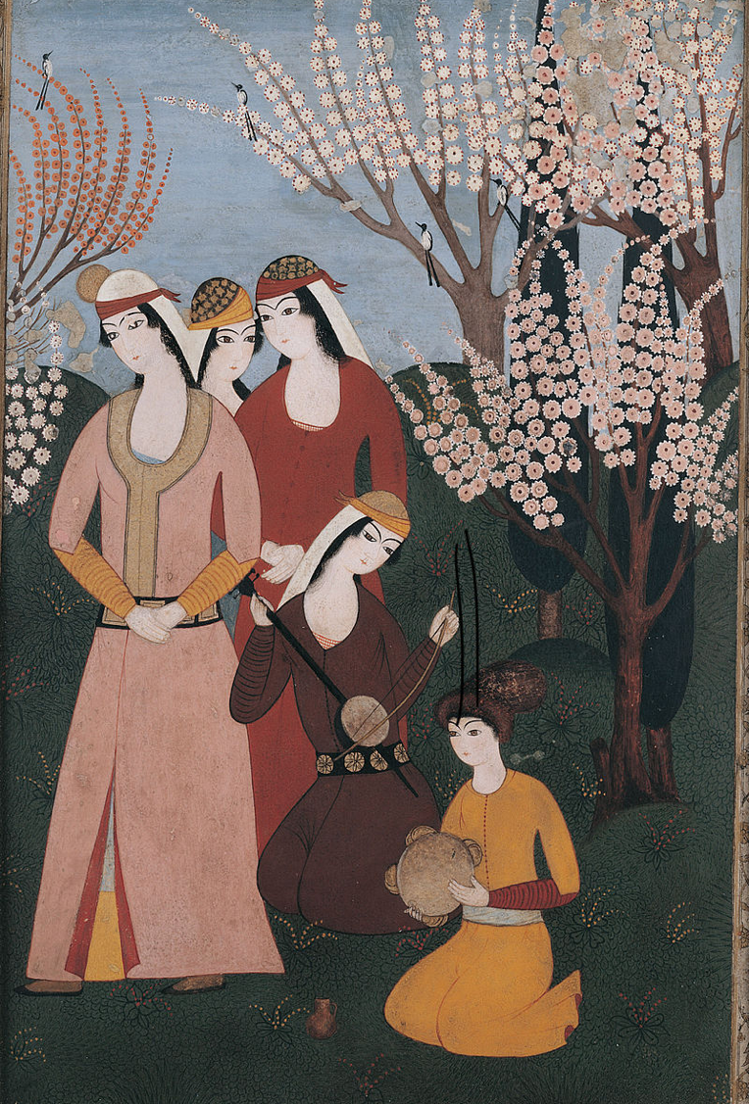

The Ottomans
Music workshop 1: Transcribing a soundscape
L.O.s
  To learn a simple line notation method of transcribing sounds
  To use this method to transcribe a soundscape inspired by an 18th Century Ottoman picture

Slide 2
Key terms warm-up
Can you match these words to their meanings?
pitch
continuous
soundscape
transcribe
to write out in a different way e.g. writing out notes from a tape recording
a combination of sounds inspired by an environment
carrying on without stopping
how high or low a sound is

Slide 3



Transcribing sounds by drawing
👂🏾
What can you hear?
What happens to the line when the pitch of the sound gets lower?
Here’s how we could represent this sound as a line drawn on paper:

Slide 4
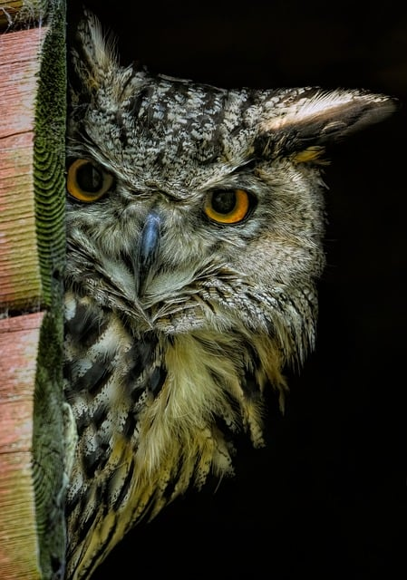

Transcribing sounds by drawing
👂🏾
What can you hear this time?
What happens to the line when there is no sound?
Here’s how we could represent this sound as a line drawn on paper:

Slide 5

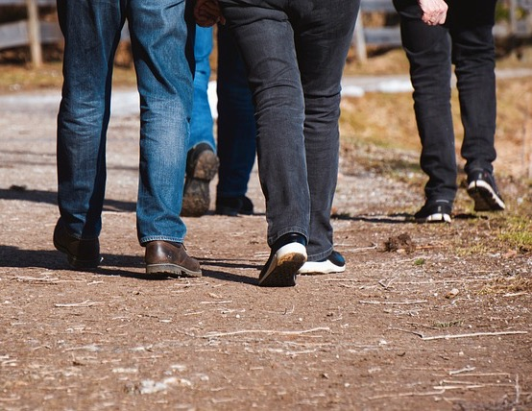
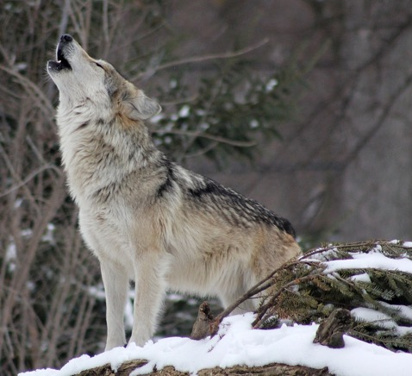
Now it’s your turn to transcribe a sound
On your white boards, draw a line from left to right to represent the sound you hear.
For a high pitch sound, draw the line toward the top of the board
For a low pitch sound, draw the line toward the bottom of the board
For a continuous sound, draw a continuous line
For a mixture of sounds and silence , put breaks in the line to show silence

Slide 6
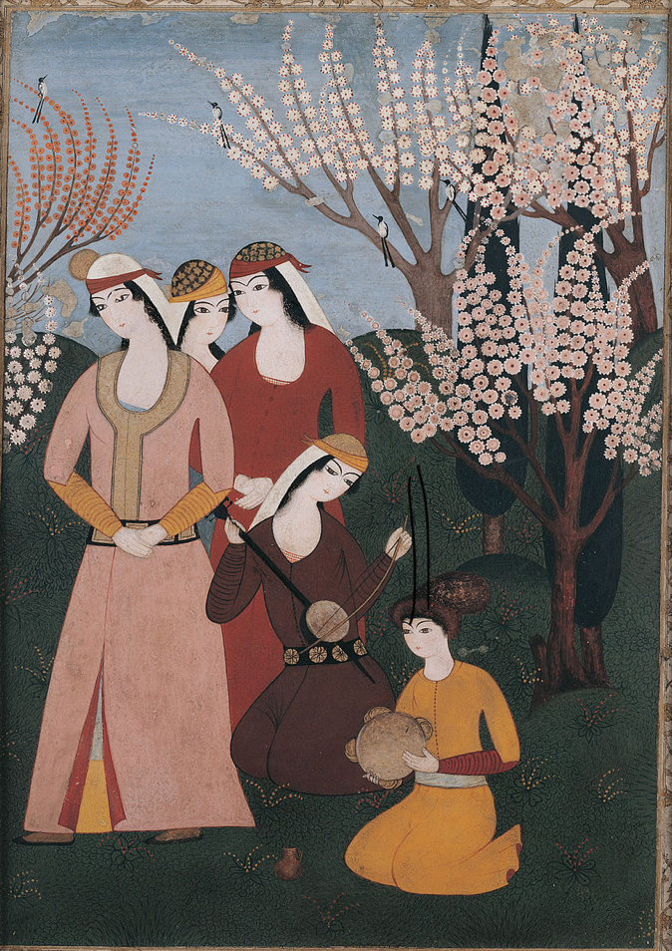
Transcribe an imaginary soundscape
Here’s an Ottoman picture we saw in our last lesson. Can you remember what’s happening here?
We’re going to imagine a soundscape to accompany this picture and record this soundscape using the line technique we just practiced.
What background noise can you imagine?
There are three birds in the picture. Are they all singing? What do their calls sound like?
How is the tambourine being played? Shaken or beaten or both? Is the rhythm slow or fast?
Tanbur player: Is the instrument making a single note or lots? Is it a continuous sound or are there breaks?
Three standing women: Are they singing along or just listening? Are they paying attention silently or chatting? Are they tapping their toes or clapping their hands to join in?
A picture of an outdoor musical gathering, 18th Century

Slide 7
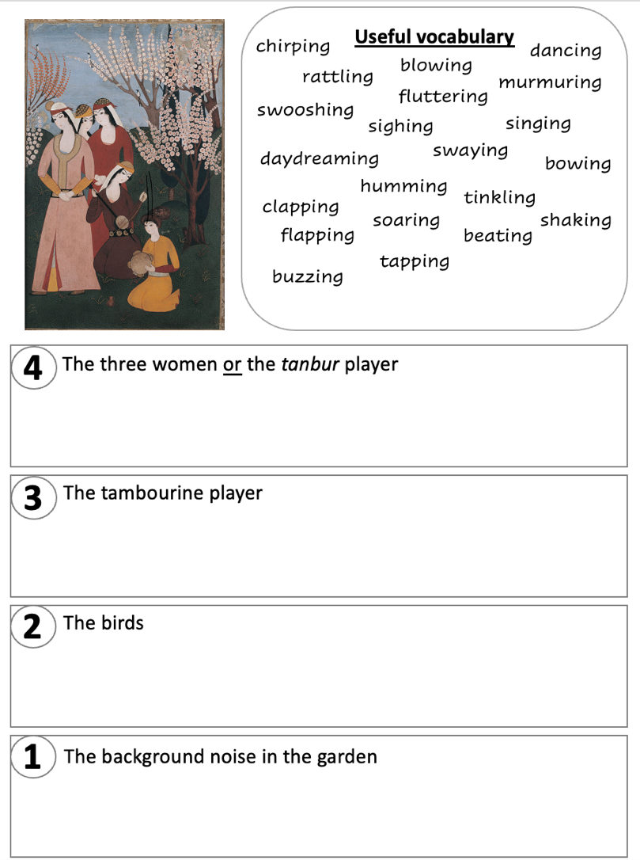

Transcribe an imaginary soundscape
Three women: Are they singing along or just listening? Are they paying attention or chatting?
Tanbur player: Is the instrument making a single note or lots? Is it a continuous sound or are there breaks?
How is the tambourine being played? Shaken or beaten or both? Is the rhythm slow or fast?
There are three birds in the picture. Are they all singing? What do their calls sound like?
What background noise can you imagine?

Slide 8
Playing back your transcriptions
Now that you’ve drawn your lines to record what the soundscape of this picture looks like, our musician can use these lines as inspiration to play back the sounds you’ve imagined.
[music specialist takes a selection of student work and interprets]

Slide 9
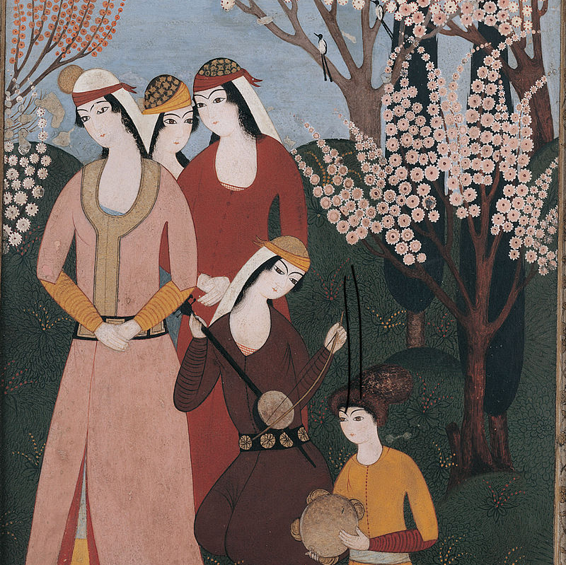
Plenary
What is ‘pitch’?
What does the word ‘transcribe’ mean?
What two main sounds can a tambourine make?

