Slide 1



Staff orientation

Slide 2
Teacher CPD
project orientation including partner organisations & aims
overview of sessions and workshops
introduction to classroom material
project contact details

Slide 3

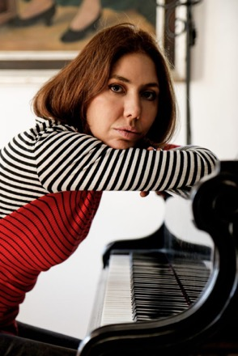

Our project delivery partners
Enfield Music Service
Elif Karlidag, composer
Gallipoli Music Memorial

Slide 4
Project outcomes & legacy
To create and publish high-quality resources for schools to explore maqam music, including:
  a dedicated website
  a comprehensive approach to teacher education
  creation of KS2 learning resource pack
  videos of professional performances, including those taking place in the project
To increase knowledge of and enthusiasm for heritage Turkish music among the pupils, staff and parents and carers of the target school, and among the wider Edmonton population
To create a national profile of Edmonton’s music-making, cultural heritage and curricular innovation by engagement with the Department for Education, universities and other establishments.

Slide 5
The offering
Teacher CPD
project orientation for staff
session 1
Professional maqam music performance with commentary on features
session 2
Class lesson on cultural background to maqam music
sessions 3 & 4
Creative response & composition workshops for students led by musician practitioner and GMM facilitator
session 5
Student performance at the school…
school
…to which parents and carers are invited
community

Slide 6
Session 1: performance
6/3/24
Led by EK & professional musicians with GMM facilitator
Welcome One of the musicians welcomes the children and briefly introduces the format of the ‘mini concert’ (performances, guided tour of instruments, joining in)
Opening piece performance
‘Guided tour’ of the musicians & their instruments Musicians demonstrate their instruments, how they’re made, what their range is, what they’re used for including voice.
Listening exercise: Students have mime tasks to complete (e.g. standing up, sitting down, hands in air) when they hear a particular instrument as the musicians replay the opening piece.
Second piece performance
Harmony exercise Lead musician highlights a harmony/chord heard in the previous piece, splits students into 3 groups, assigns a note to each group and gets them to harmonise.
Clapping exercise Musicians play piece, then highlight a rhythm featured in it. Students are shown how to clap back a simple rhythm. Students then clap along rhythm when piece is played again
Closing piece performance
Programme exposition GMM facilitator/teacher explains the structure of the upcoming programme to the students with a focus on becoming composers

Slide 7
Session 2: Ottoman history lesson
week of 13/3/24
Led by class teacher
pre-made lesson plan and digital resources
setting the context for the workshops
class teacher-delivered
will be covered in more detail later in this session

Slide 8
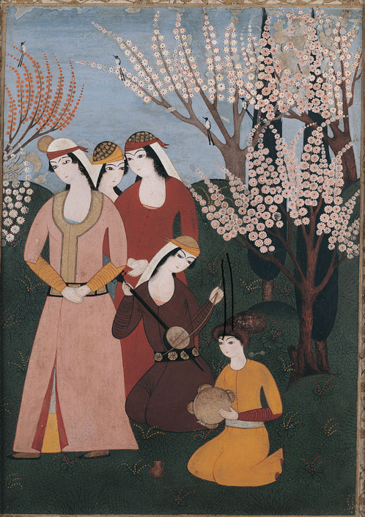
Session 3: Soundscape workshop 1
17/4/24
Led by Music Specialist (MS) and GMM Facilitator, supported by class teacher
L.O.s
  To learn a simple line notation method of transcribing sounds
  To use this method to transcribe a soundscape inspired by an 18th Century Ottoman picture

Slide 9

Session 4: Soundscape workshop 2
24/4/24
Led by Music Specialist (MS) and GMM Facilitator, supported by class teacher
L.O.s
  To learn about and listen to dynamic elements in music
  To use colour on our visual notation to add dynamic elements to and enrich our to soundscapes inspired by an 18th Century Ottoman picture

Slide 10
Session 5: Performance of student composition
8/5/24
Composer Elif will take students’ compositions, transcribe them into one piece.
Piece will be performed to the children and the community by the Turkish musicians

Slide 11
Session 1: Ottoman History & Culture
Teacher-led lesson in detail

Slide 12
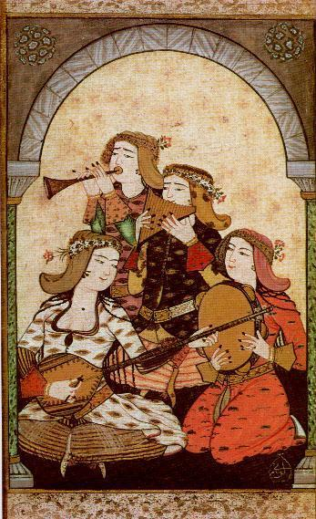

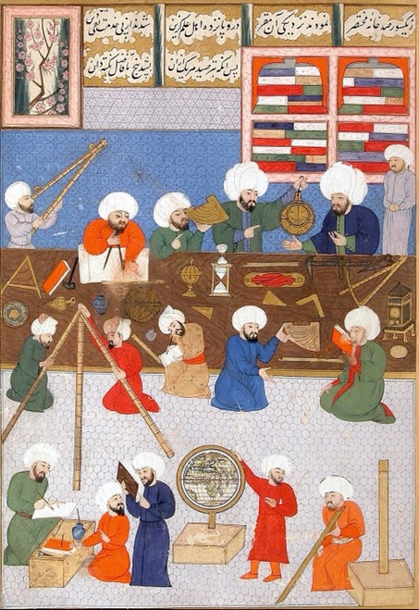
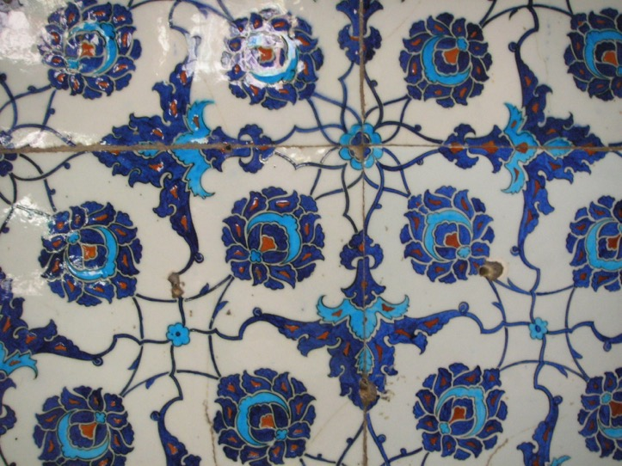
The Ottomans
L.O. To learn about the history & culture of the Ottomans and to create an iznik tile pattern

Slide 13

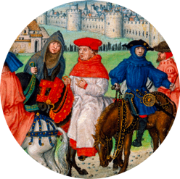
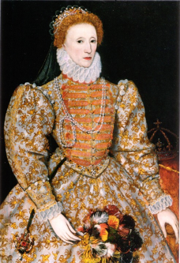
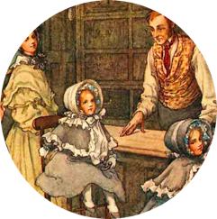
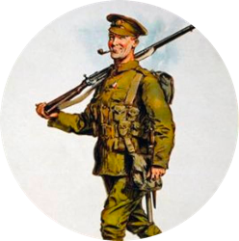
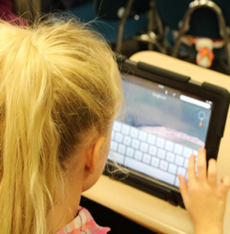
Time travel through British history
Middle Ages
1066-1485
Tudors & Elizabethans 1485-1603
Georgians & Victorians
1714-1901
20th Century
1900-1999
Modern times
1000 years ago
600 years ago
300 years ago
100 years ago

Slide 14

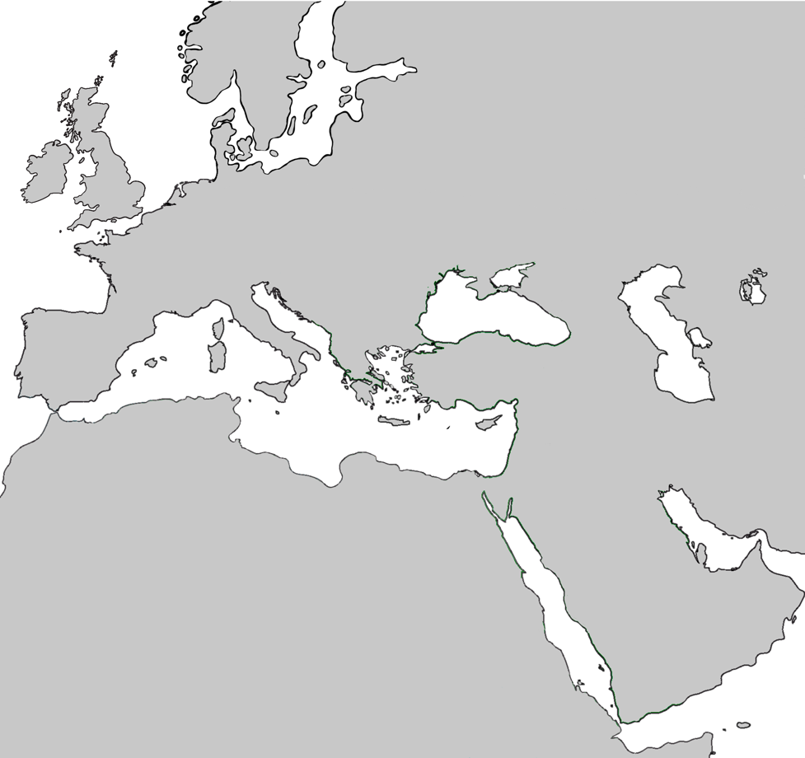
Eastwards From Britain
We just looked at the timeline for British history.
Can you identify Britain on this map?
Let’s move eastwards and look at the history of a different culture.
The country that in modern times we now call Türkiye (Turkey) was the centre of the Ottoman civilization, an important culture for hundreds of years.

Slide 15
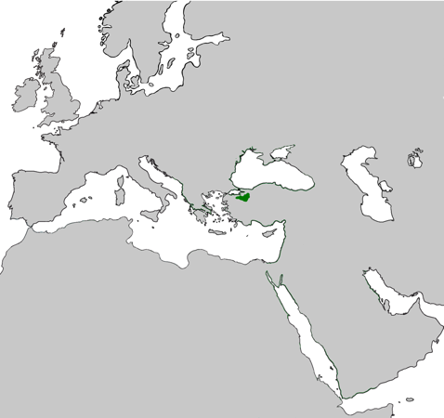
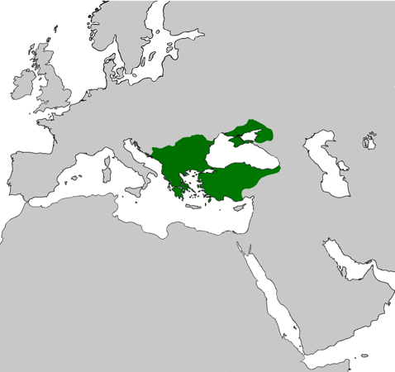
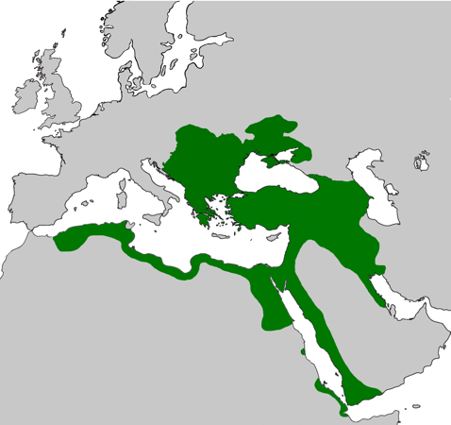
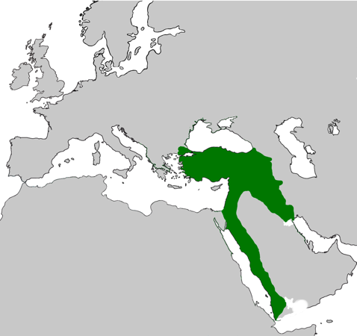
Ottoman civilisation
700 years ago
600 years ago
300 years ago
100 years ago
The Ottomans started off by ruling a small area in what is now northern Türkiye (Turkey).
The lands they controlled grew over time to include Greece, Serbia and Crimea.
At their most powerful, the Ottomans controlled a large part of Eastern Europe, North Africa and the Middle East.
Their lands eventually decreased in size as events such as wars in the 19th and 20th centuries unfolded.

Slide 16

Ottoman achievements & discoveries
Science
What do you think these people in the picture are doing?
What objects can you see in the background of the picture? What things can you see in the foreground?
What does this tell us about these people shown here?
Astronomers at the Taqi al Din observatory
(place for looking at the stars in the night sky), 1577-1580

Slide 17
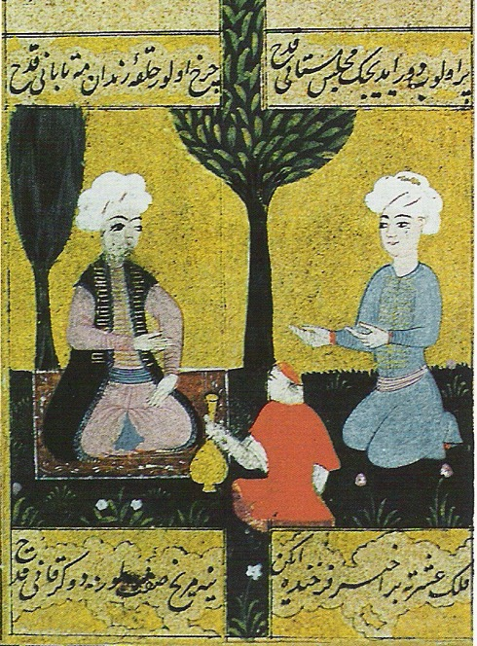
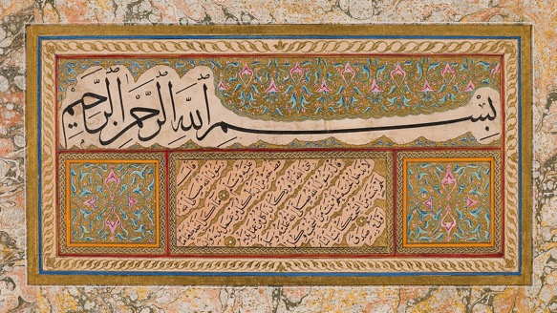
Ottoman achievements & discoveries
Writing
Ottoman culture produced great poetry & stories
Which one of these people do you think is the poet? Why do you think this?
What do you think the person holding the bottle is doing?
Ottoman writers also practiced calligraphy, the art of making written words decorative
Can you see the letters in Arabic script?
Page of a book written by Sheikh Hamdullah (1436–1520)
A poet and guest in a garden,
16th century picture

Slide 18

Ottoman achievements & discoveries
Music
Playing and listening to music was an important part of Ottoman life
What kinds of instruments can you see being played here?
Are any of them similar to the instruments you heard in the concert you were at?
A picture of an outdoor musical gathering, 18th Century
A picture of a band of female musicians, 1720

Slide 19
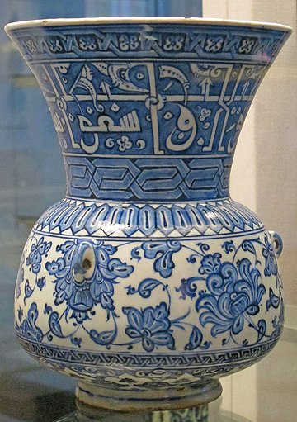

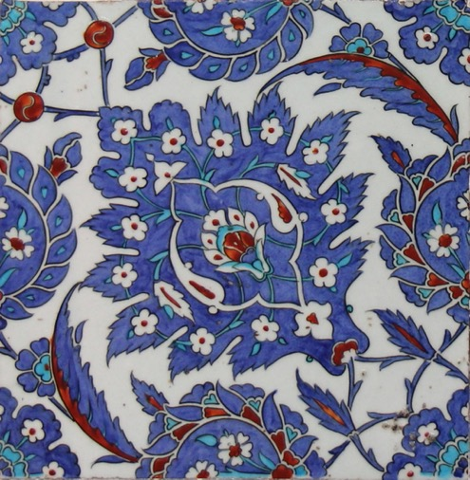
Ottoman achievements & discoveries
Design
A famous style of ceramic decoration, known as iznik, originated from the time of the Ottomans.
What shapes can you see painted on these pieces of pottery?
What colours have the artists used to decorate their works? What main colour is used?
The iznik style often makes use of symmetry. Can you spot any symmetrical decorations?
Iznik mosque lamp, 16th Century
Iznik tiles, 16th Century (above),
18th Century (left)

Slide 20
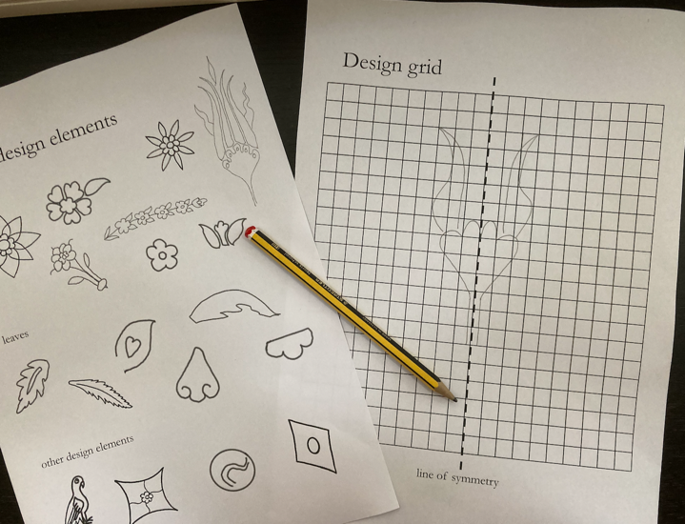
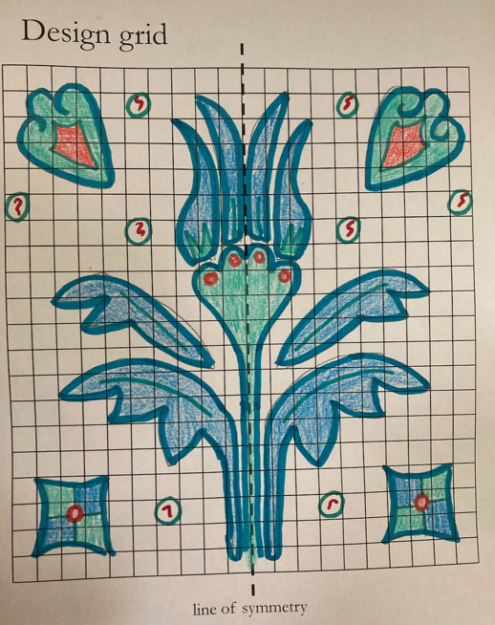
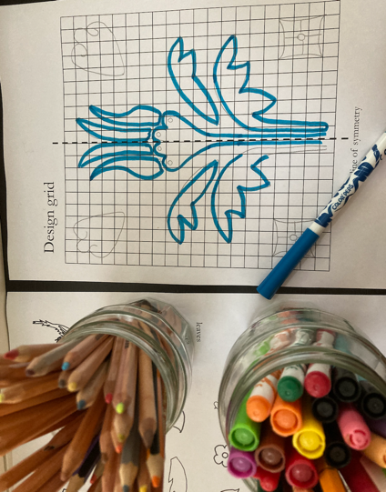
Task instructions
Your task is to design a symmetrical, square iznik tile
Start by creating a pattern in the left-hand side of your worksheet. There are some iznik-inspired shapes to inspire you – copy or trace them onto your worksheet. Use the grid and the central line of symmetry to reflect what is in the left hand design.
Colour or paint your design. Remember that blue and white are very important!

Slide 21




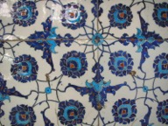


Plenary quiz
Name a science that the Ottomans were skilled at.
The Ottomans practiced the art of calligraphy. What is calligraphy?
What is the name starting with ‘i’ that describes the famous Ottoman style of pottery decoration?

Slide 22
Session 2: Soundscape workshop 1
Music-Practitioner & Facilitator-led lesson in detail

Slide 23
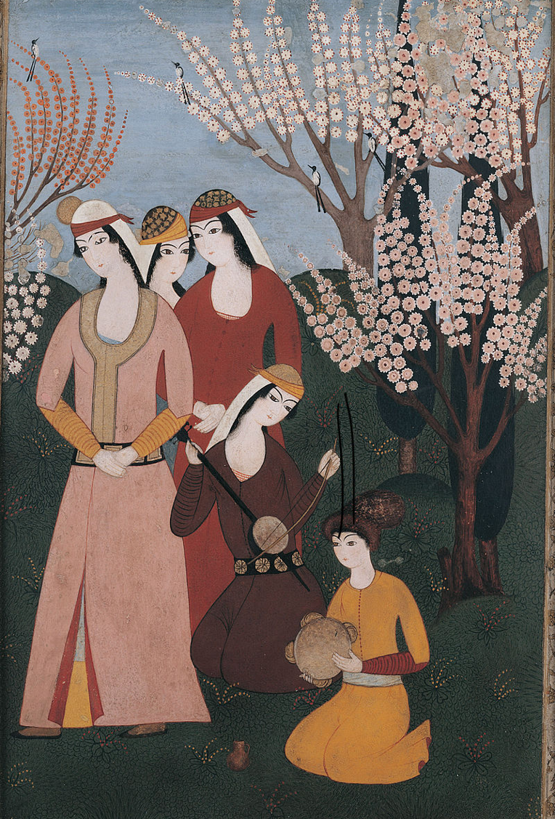

The Ottomans
Music workshop 1: Transcribing a soundscape
L.O.s
  To learn a simple line notation method of transcribing sounds
  To use this method to transcribe a soundscape inspired by an 18th Century Ottoman picture

Slide 24
Key terms warm-up
Can you match these words to their meanings?
pitch
continuous
soundscape
transcribe
to write out in a different way e.g. writing out notes from a tape recording
a combination of sounds inspired by an environment
carrying on without stopping
how high or low a sound is

Slide 25



Transcribing sounds by drawing
👂🏾
What can you hear?
What happens to the line when the pitch of the sound gets lower?
Here’s how we could represent this sound as a line drawn on paper:

Slide 26
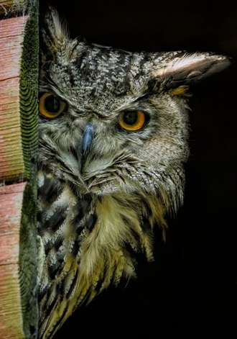
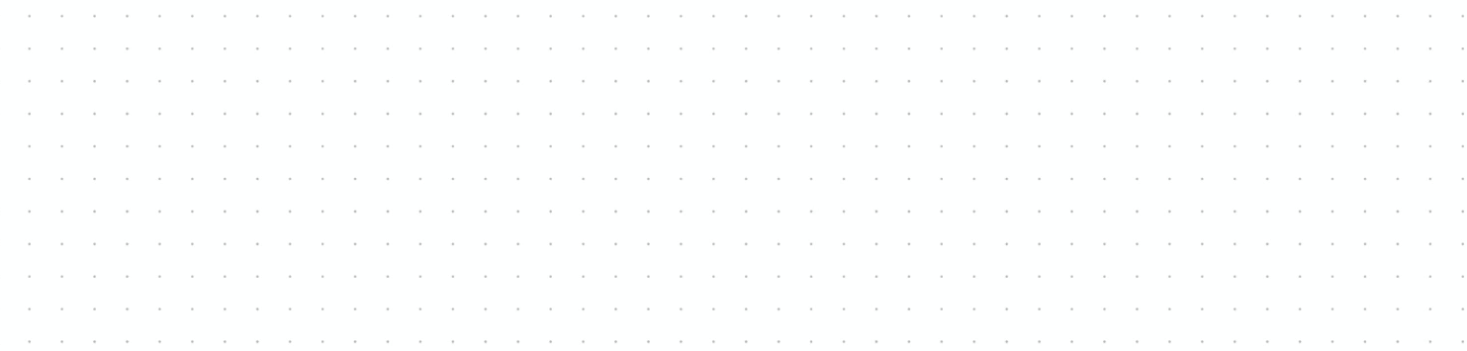
Transcribing sounds by drawing
👂🏾
What can you hear this time?
What happens to the line when there is no sound?
Here’s how we could represent this sound as a line drawn on paper:

Slide 27

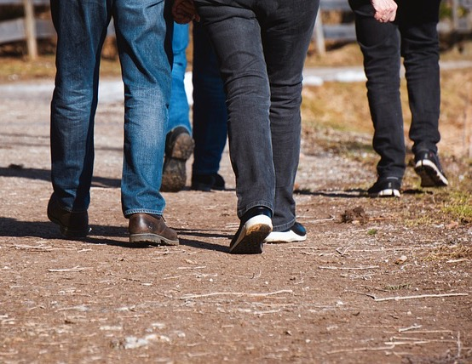
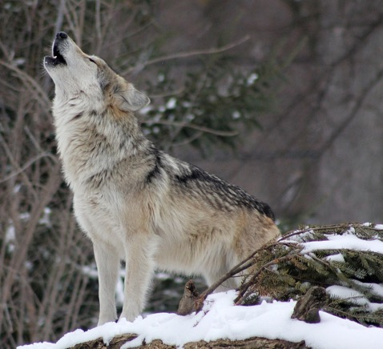
Now it’s your turn to transcribe a sound
On your white boards, draw a line from left to right to represent the sound you hear.
For a high pitch sound, draw the line toward the top of the board
For a low pitch sound, draw the line toward the bottom of the board
For a continuous sound, draw a continuous line
For a mixture of sounds and silence , put breaks in the line to show silence

Slide 28

Transcribe an imaginary soundscape
Here’s an Ottoman picture we saw in our last lesson. Can you remember what’s happening here?
We’re going to imagine a soundscape to accompany this picture and record this soundscape using the line technique we just practiced.
What background noise can you imagine?
There are three birds in the picture. Are they all singing? What do their calls sound like?
How is the tambourine being played? Shaken or beaten or both? Is the rhythm slow or fast?
Tanbur player: Is the instrument making a single note or lots? Is it a continuous sound or are there breaks?
Three standing women: Are they singing along or just listening? Are they paying attention silently or chatting? Are they tapping their toes or clapping their hands to join in?
A picture of an outdoor musical gathering, 18th Century

Slide 29
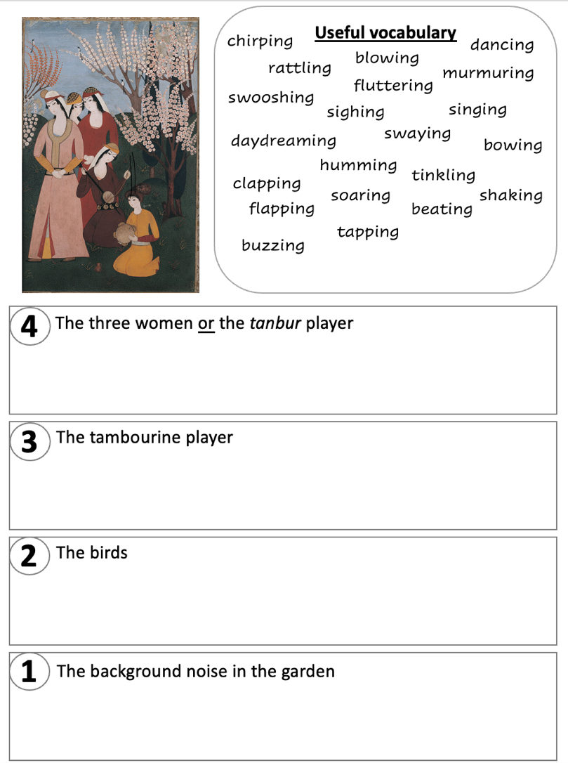

Transcribe an imaginary soundscape
Three women: Are they singing along or just listening? Are they paying attention or chatting?
Tanbur player: Is the instrument making a single note or lots? Is it a continuous sound or are there breaks?
How is the tambourine being played? Shaken or beaten or both? Is the rhythm slow or fast?
There are three birds in the picture. Are they all singing? What do their calls sound like?
What background noise can you imagine?

Slide 30
Playing back your transcriptions
Now that you’ve drawn your lines to record what the soundscape of this picture looks like, our musician can use these lines as inspiration to play back the sounds you’ve imagined.
[music specialist takes a selection of student work and interprets]

Slide 31
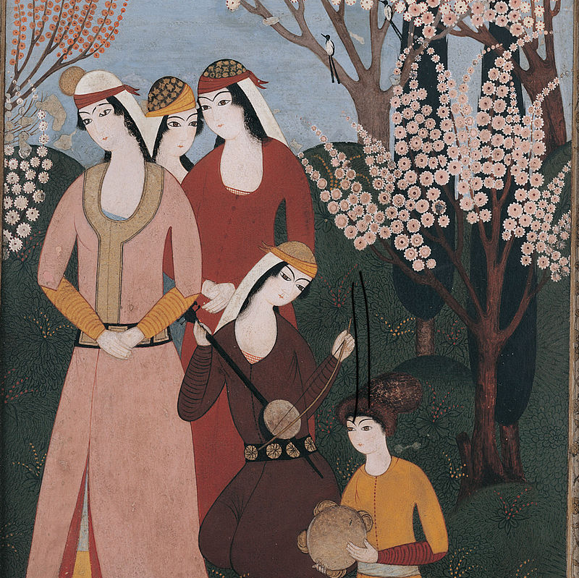
Plenary
What is ‘pitch’?
What does the word ‘transcribe’ mean?
What two main sounds can a tambourine make?

Slide 32
Further information & contact details
charlie.m.andrew@gmail.com
https://beatingthedrumn9.wordpress.com
http://elifkarlidag.com
www.gallipolimusic.co.uk
www.enfield.gov.uk/services/property-and-economy/untold-edmonton

