Slide 1
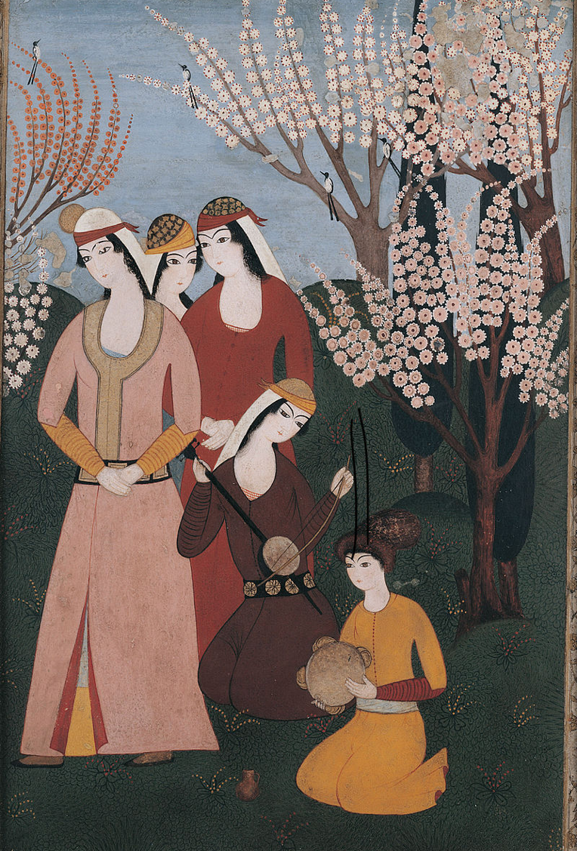

The Ottomans
Music workshop 2: Developing our soundscape
L.O.s
  To learn about and listen to dynamic elements in music
  To use visual notation to add dynamic elements to and enrich our to soundscapes inspired by an 18th Century Ottoman picture

Slide 2
Key terms warm-up
Can you match these words to their meanings?
volume
decrease
increase
pitch
to become more of something, or to get bigger
to become less of something, or to get smaller
how loud or quiet a sound is
how high or low a sound is

Slide 3
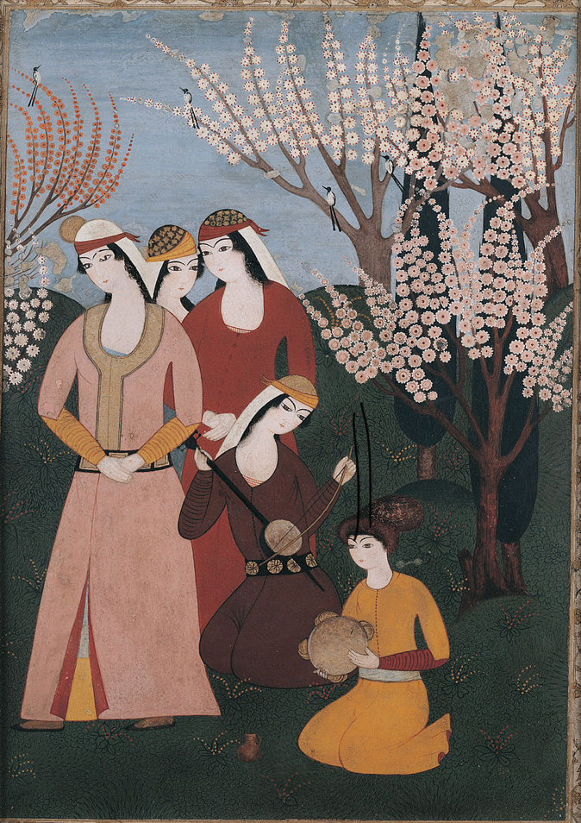
Our soundscape
Here’s the Ottoman picture we used as inspiration to create our soundscapes in the last lesson.
Can you remember the four things we used as inspiration for our soundscape?
The birds
The background noise of the garden
The two women playing instruments
The three women standing

Slide 4
Our soundscape
We recorded our soundscapes by drawing a line.
How did we show high or low pitch?
How did we show silence?
Today we’re going to add to our soundscapes to show sounds increasing or decreasing in volume .

Slide 5

Transcribing increasing & decreasing volume
👂🏾
Listen to this short piece of music and watch how we could transcribe it.
👂🏾
Listen again and this time listen out for when the music’s volume increases and gets louder. When you hear it, hold up your red card.

Slide 6

Transcribing increasing & decreasing volume
We can use colours on our transcription to show increasing and decreasing volume.
red = loud
Here’s how we could represent this increasing volume:

Slide 7


Transcribing increasing & decreasing volume
We can use colours on our transcription to show increasing and decreasing volume.
blue = quiet
Here’s how we could represent this quieter volume:

Slide 8
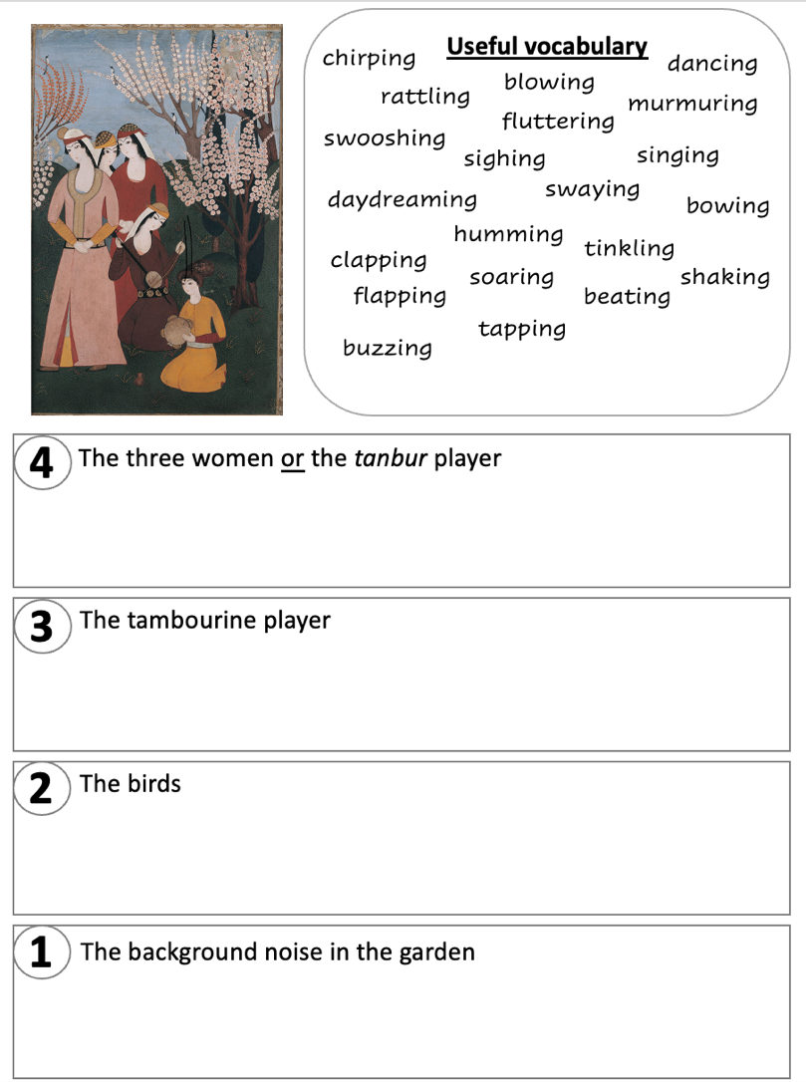
Transcribing volume onto our imaginary soundscapes
Three women: If your women are talking or singing, are they doing it quietly or loudly? Are they all talking at once? If they start clapping, what will this do to the volume of your soundscape?
Tanbur player: Is the instrument playing at the same volume all the time, or does its volume increase or decrease over time?
Is the tambourine being shaken or tapped hard or softly? Does the shaking make a louder noise than the tapping?
How loud are the birds? Are they all singing at the same volume?
Is the background noise quiet or loud? Does it change in volume or stay the same?

Slide 9
Playing back your transcriptions
Now that you’ve used colour on your lines to record changing volume on your soundscape, our musician can use these lines as inspiration to play back the sounds you’ve imagined.
[music specialist takes a selection of student work and interprets]

Slide 10
What happens next
Our musician is going to take your soundscape transcripts and put them all together as one piece of music.
You’ll then present your musical composition, which will be performed by professional musicians, in a concert at your school.

Slide 11
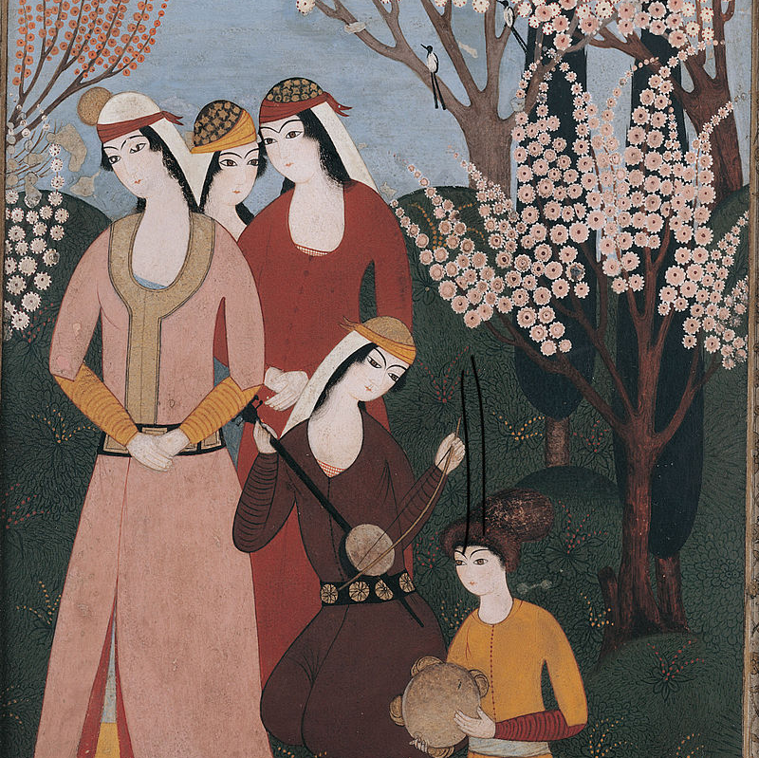
Plenary
What is ‘volume’?
How did you show an increase in volume in your soundscape notation?
How did you show a decrease in volume in your soundscape notation?

