Slide 1
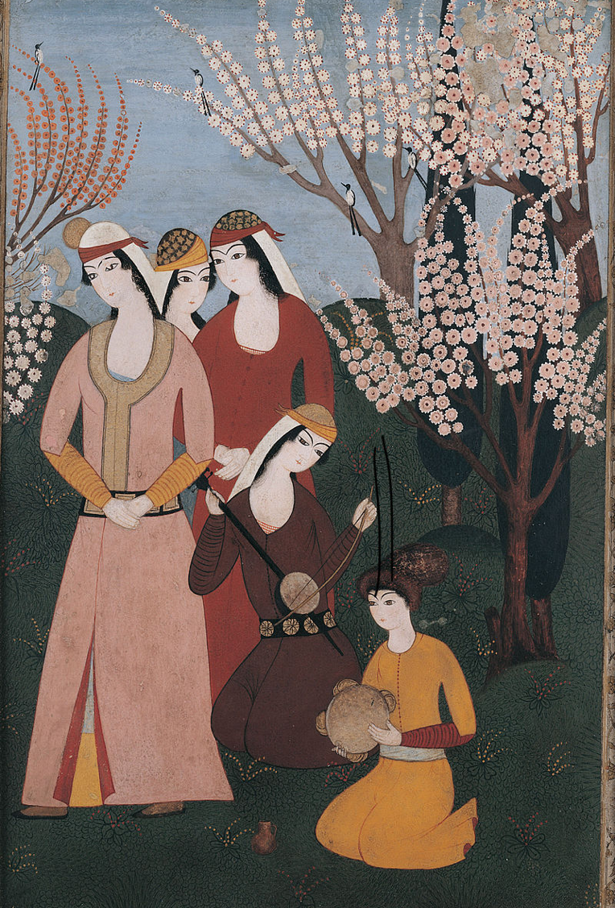

The Ottomans
Music workshop part 1: Transcribing a soundscape
L.O.s
  To learn a simple line notation method of transcribing sounds
  To use this method to transcribe a soundscape inspired by an 18th Century Ottoman picture

Slide 2
Key terms warm-up
Can you match these words to their meanings?
pitch
continuous
soundscape
transcribe
to write out in a different way e.g. writing out notes from a tape recording
a combination of sounds inspired by an environment
carrying on without stopping
how high or low a sound is

Slide 3




Transcribing sounds by drawing
What can you hear?
What happens to the line when the pitch of the sound gets lower?
Here’s how we could represent this sound as a line drawn on paper:

Slide 4
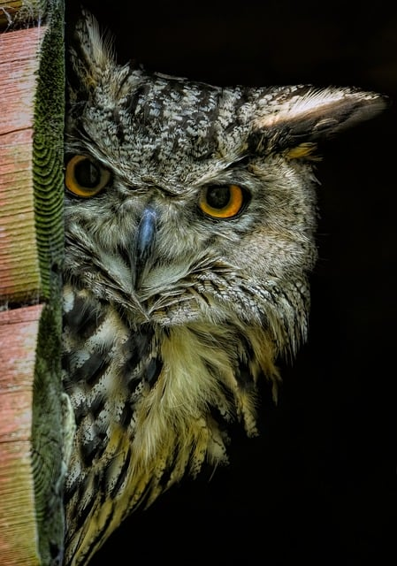
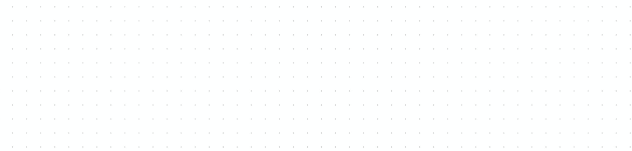
Transcribing sounds by drawing
What can you hear this time?
What happens to the line when there is no sound?
Here’s how we could represent this sound as a line drawn on paper:

Slide 5

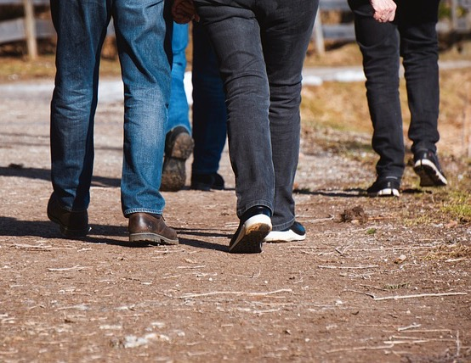
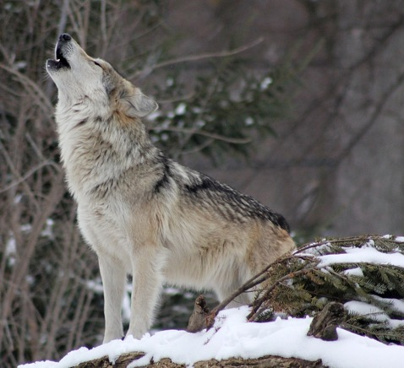
Now it’s your turn to transcribe a sound
On your white boards, draw a line from left to right to represent the sound you hear.
For a high pitch sound, draw the line toward the top of the board
For a low pitch sound, draw the line toward the bottom of the board
For a continuous sound, draw a continuous line
For a mixture of sounds and silence , put breaks in the line to show silence

Slide 6
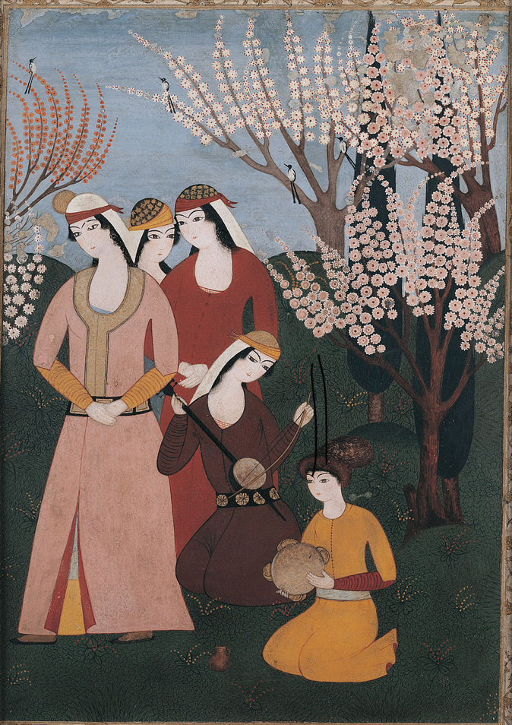
Transcribe an imaginary soundscape
Here’s an Ottoman picture we saw in our last lesson. Can you remember what’s happening here?
We’re going to imagine a soundscape to accompany this picture and record this soundscape using the line technique we just practiced.
What background noise can you imagine?
There are three birds in the picture. Are they all singing? What do their calls sound like?
How is the tambourine being played? Shaken or beaten or both? Is the rhythm slow or fast?
Kemence player: Is the instrument making a single note or lots? Is it a continuous sound or are there breaks?
Three standing women: Are they singing along or just listening? Are they paying attention silently or chatting? Are they tapping their toes or clapping their hands to join in?
A picture of an outdoor musical gathering, 18th Century

Slide 7
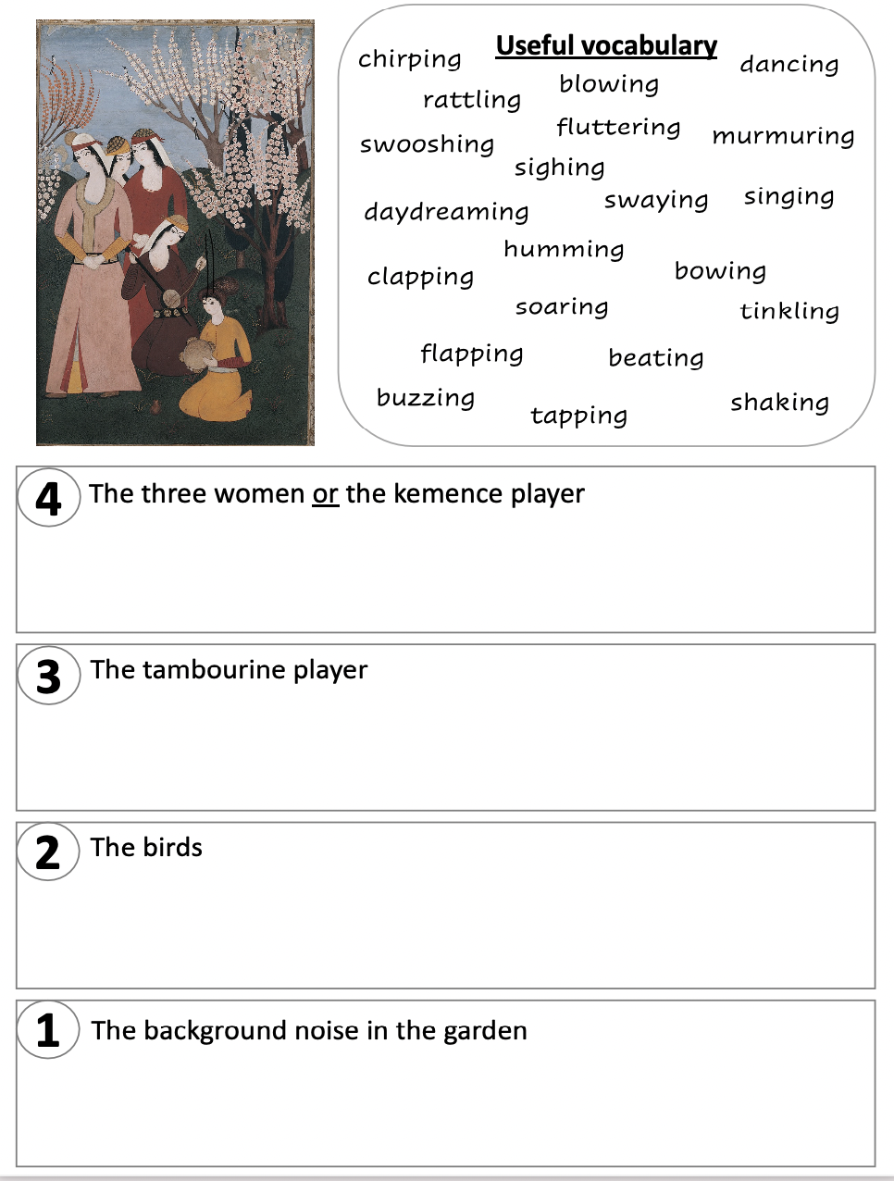

Transcribe an imaginary soundscape
Three women: Are they singing along or just listening? Are they paying attention or chatting?
Kemence player: Is the instrument making a single note or lots? Is it a continuous sound or are there breaks?
How is the tambourine being played? Shaken or beaten or both? Is the rhythm slow or fast?
There are three birds in the picture. Are they all singing? What do their calls sound like?
What background noise can you imagine?

Slide 8
Playing back your transcriptions
Now that you’ve drawn your lines to record what the soundscape of this picture looks like, our musician (and you!) can use these lines as inspiration to play or sing back the sounds you’ve imagined.

Slide 9
The Ottomans
Music workshop Part 2: Developing our soundscape
L.O.s
  To learn about and listen to dynamic elements in music
  To use colour to add dynamic elements to and enrich our to soundscapes inspired by an 18th Century Ottoman picture

Slide 10
Our soundscape
We’ve recorded our soundscapes by drawing a line.
How did we show high or low pitch?
How did we show silence?
Now we’re going to add to our soundscapes to show sounds increasing or decreasing in volume .

Slide 11
Key terms warm-up
Can you match these words to their meanings?
volume
decrease
increase
pitch
to become more of something, or to get bigger
to become less of something, or to get smaller
how loud or quiet a sound is
how high or low a sound is

Slide 12

Transcribing increasing & decreasing volume
Listen to this short piece of music and watch how we could transcribe it.
Listen again and this time listen out for when the music’s volume increases and gets louder. When you hear it, put up your hand.

Slide 13

Transcribing increasing & decreasing volume
We can use colours on our transcription to show increasing and decreasing volume.
red = loud
Here’s how we could represent this increasing volume:

Slide 14


Transcribing increasing & decreasing volume
We can use colours on our transcription to show increasing and decreasing volume.
blue = quiet
Here’s how we could represent this quieter volume:

Slide 15
Transcribing volume onto our imaginary soundscapes
Three women: If your women are talking or singing, are they doing it quietly or loudly? Are they all talking at once? If they start clapping, what will this do to the volume of your soundscape?
Kemence player: Is the instrument playing at the same volume all the time, or does its volume increase or decrease over time?
Is the tambourine being shaken or tapped hard or softly? Does the shaking make a louder noise than the tapping?
How loud are the birds? Are they all singing at the same volume?
Is the background noise quiet or loud? Does it change in volume or stay the same?

Slide 16
What happens next
Composer Elif is going to take your soundscape transcripts and put them together to make a piece of music.
You’ll then present your musical composition, which will be performed by professional musicians, in a concert at your school.

Slide 17
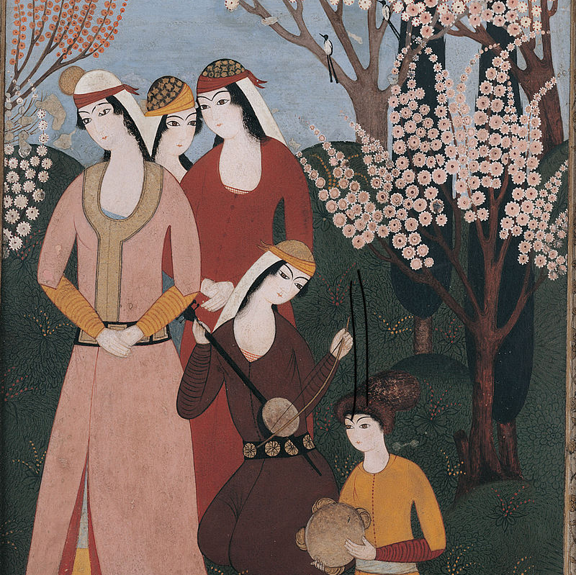
Plenary
What is ‘pitch’?
What does the word ‘transcribe’ mean?
What is a ‘soundscape’?

